Slide 1
Interpreting ViQET scores, when can users’ see a difference?
Jim Scovell¹, Phil Corriveau¹, Hannah Colett¹, Naeem Ramzan², Glenn Van Wallendael³, Lucjan Janowski⁴
¹ Intel Corporation
² University of West Scotland
³ Ghent University
⁴ AGH University

Slide 2
Study Goals
Ensure results are consistent with original crowdsourcing data and consistent across sites.
Determine a threshold for where users’ can begin to see a difference between photos of the same content.
Are users’ more sensitive to differences for specific types of content?

Slide 3
Study Design: Phase 1
Test harness was designed to present pairs of photos on 2 monitors
Participants were asked to select the photo they believe is of higher quality
Photo pairs were selected to compare 2 images of the same content
Minor discrepancies as content is not the exact same
Photo pairs have MOS deltas ranging from 0.273 to 0.946
220 pairs were presented to users
Included 10 repeats as a measure of reliability
Photos were selected to spread the rating scale and balanced by scene
Photo pairs were randomized

Slide 4
Study Design: Phase 2
Test harness was designed to present a photo on one monitor and 5 point rating scale on the other.
Participants will be asked to rate the quality of the photo
Photo are randomized
51 photos will be presented to users for rating
36 photos independent to each site to allow for a larger sample of photos to be rated
9 photos were the same at each site as a control to ensure site consistency across sites
6 photos were presented twice as a measure of reliability
MOS Scale
Excellent | 5.0
Good | 4.0
Fair | 3.0
Poor | 2.0
Bad | 1.0
Notes:
To prevent fatigue a mandatory break will be taken 10 minutes after users begin photo selection task

Slide 5
Phase 1 Content
Indoor (14 pairs each)
Beach Toys
Flowers
Evacuation Plan
Fruit bowl
Bridge drawing
Landscape (14 pairs each)
Autumn Mountain
Tree Lake
Ghent city
Green Tree
Levi Stadium
Night (14 pairs each)
Building
Building Corner
Parking
Pipes
Mirror Ball
Total photo pairs: 220 (10 repeats)
Phase 2 Content
Indoor (3 photos each)
Beach Toys
Flowers
Evacuation Plan
Fruit bowl
Bridge drawing
Landscape (3 photos each)
Autumn Mountain
Tree Lake
Ghent city
Green Tree
Levi Stadium
Night (3 photos each)
Building
Building Corner
Parking
Pipes
Mirror Ball
Total photos : 51 (36 independent for each site, 9 control, 6 repeats)

Slide 6
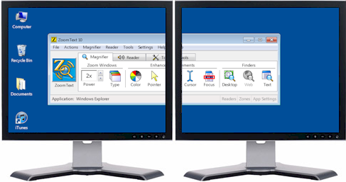
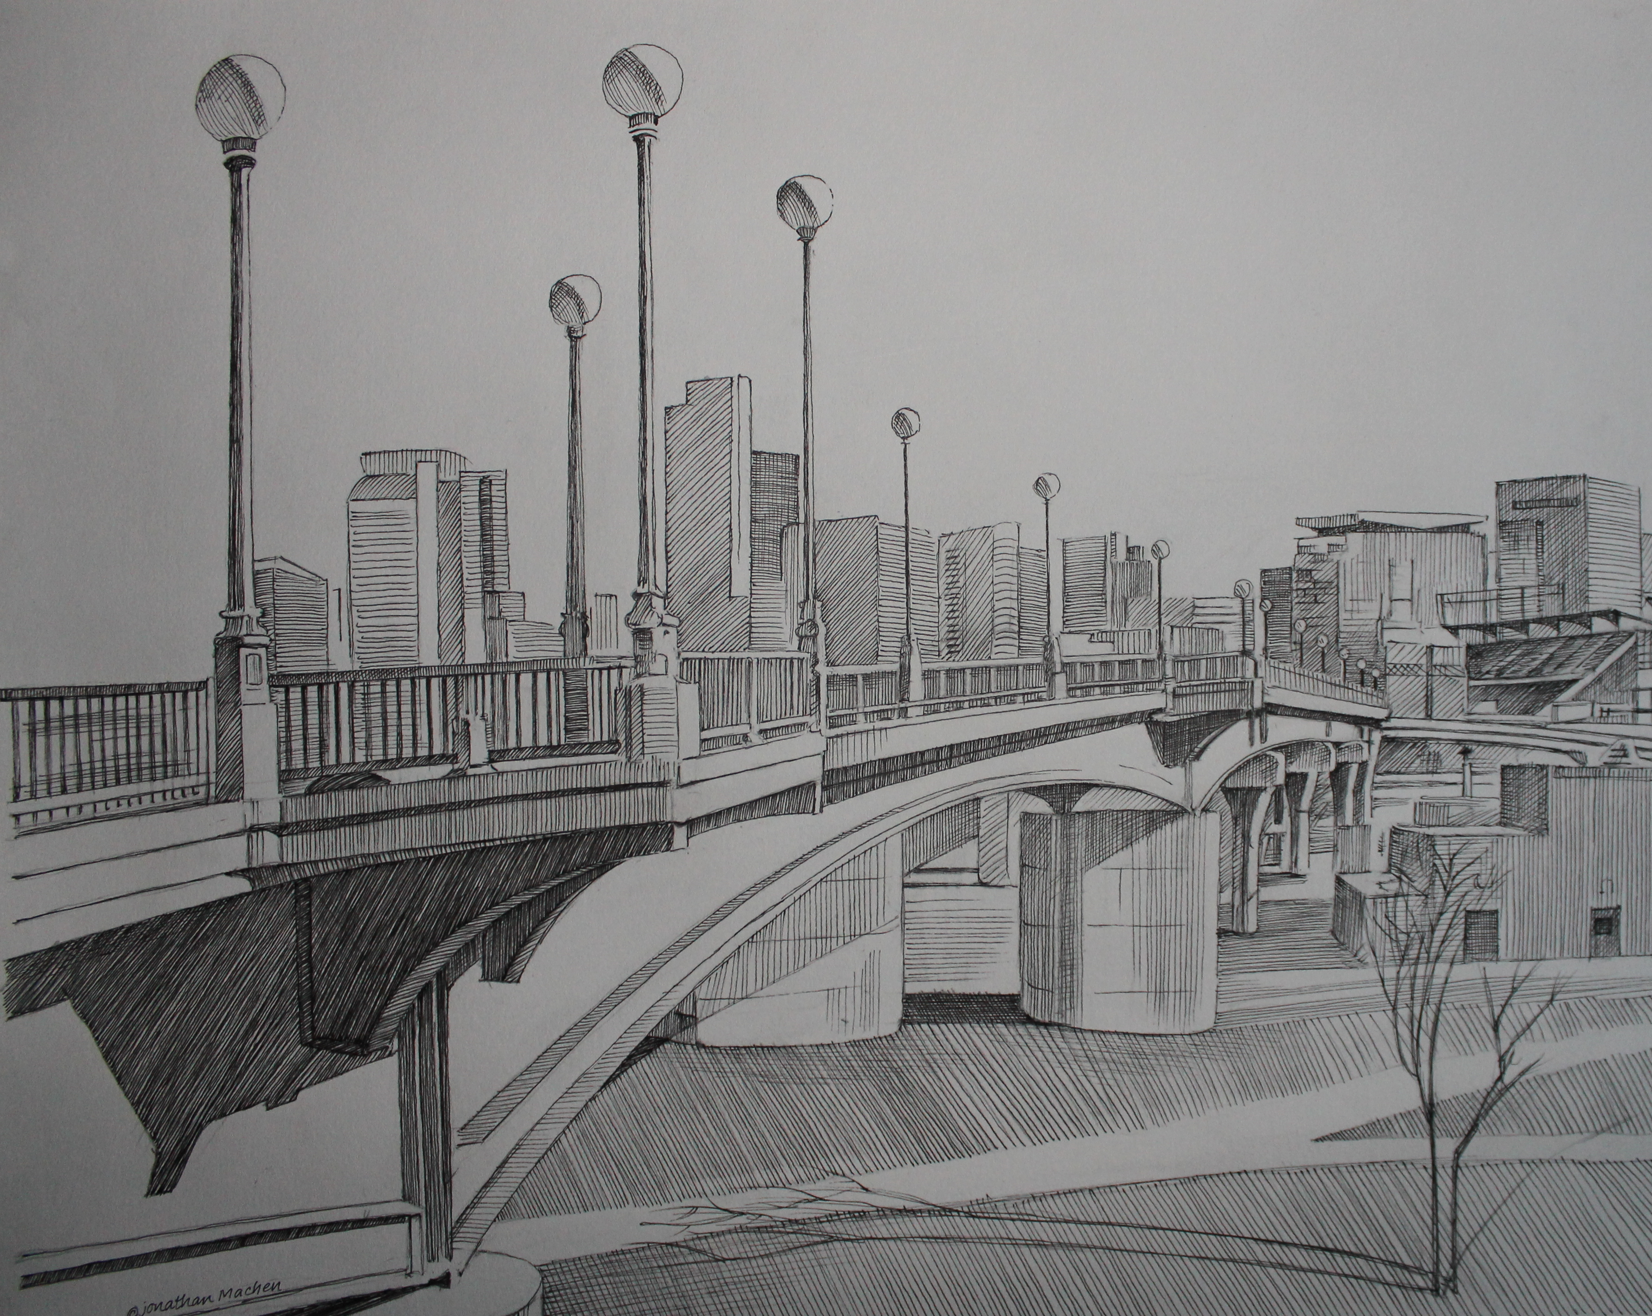
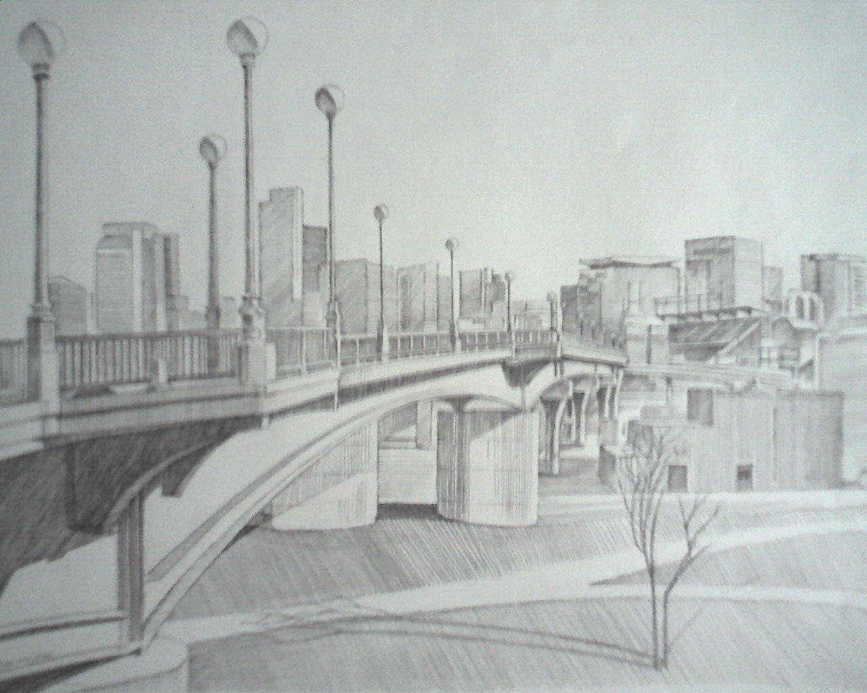
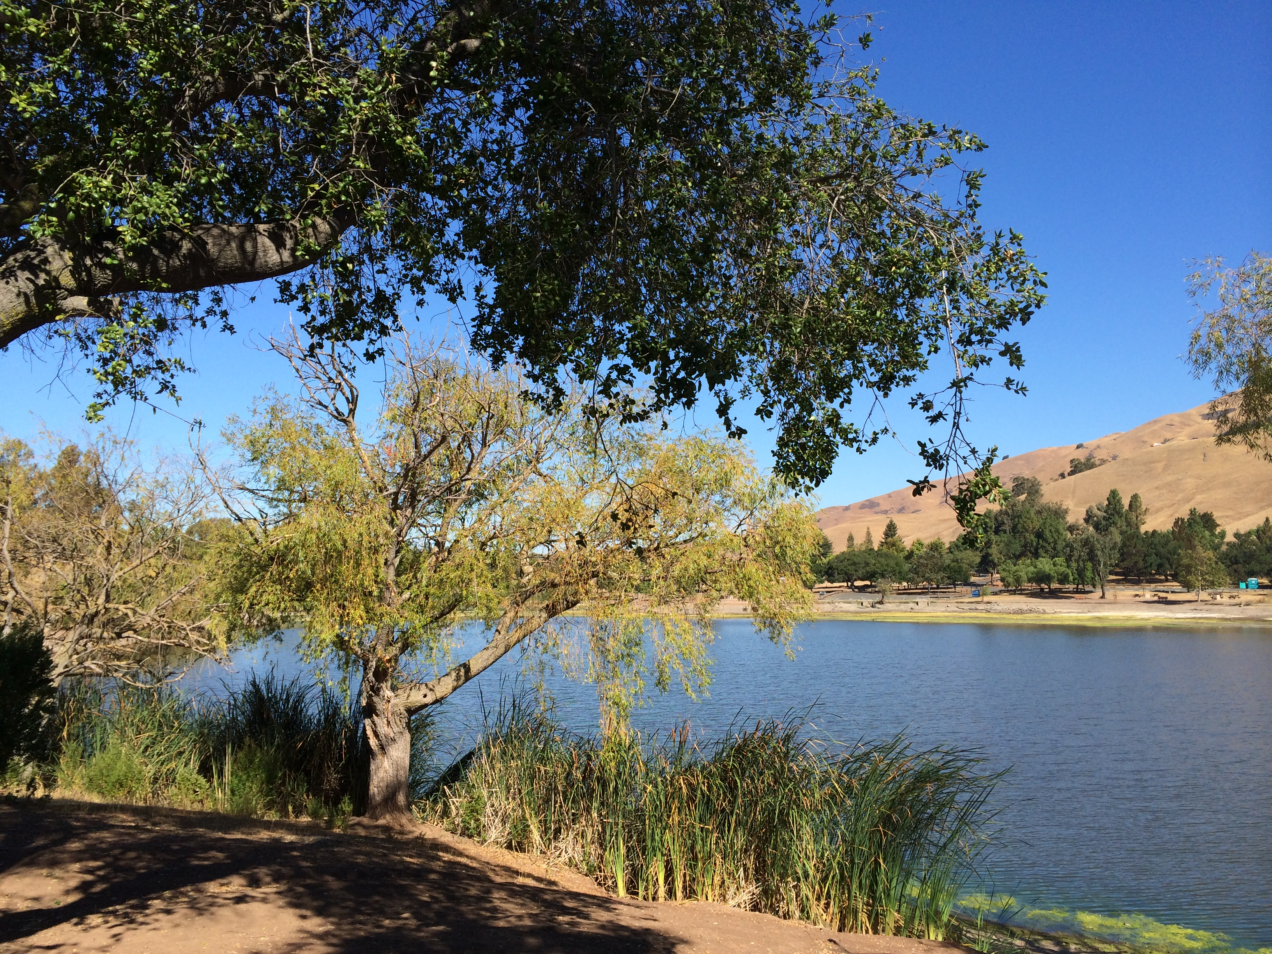
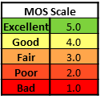
Experimental Design
Phase 1 Setup
Phase 2 Setup
Goal: Understand when users’ can start to notice
difference in photo quality
Users asked to select the image of higher quality
Dual monitor setup with 2 images of the same
scene
Participant 3H from displays
Goal: Ensure ratings from current study are not
significantly different from previous studies
Users asked to rate the quality of the photo
Dual monitor setup with 2 images of the same
scene
Participant 3H from displays

Slide 7
Participant Location Information
Intel lab in Oregon, USA
N = 36
Ghent University in Belgium
N = 31
University of West Scotland
N=24
AGH University in Poland
Data pending

Slide 8
Relationship between Sample MOS and Crowd Sourcing
While the ratings from Ghent are lower on average than the other 2 sites, there is still a good relationship between Ghent ratings and crowd sourcing ratings.

Slide 9
Impact of Scene Type
Indoor
Landscape
Night
While individual scenes were statistically different, there is no difference between scene types
Notes:
Scale 1-5, title, intervals of 1, Ariel, text size

Slide 10
Predictive Model
The threshold for when at least 50% of photo pairs will have the higher photo selected at least 75% of the time is 0.42 MOS.

Slide 11
Results Summary
Results between labs was not significantly different and ratings were consistent with original crowd sourcing data.
Based on the 91 participants the threshold for when at least 50% of photo pairs will have the higher photo selected at least 75% of the time is 0.42 MOS.
While users’ were significantly better at determining differences for certain scenes there was no significant difference between scene types.

Slide 12
Next Steps
Include additional data from AGH University and redo data analysis
Develop publication plan and point person

